Slide 1

CHAPTER 2
THE LOGIC OF COMPOUND STATEMENTS
Copyright © Cengage Learning. All rights reserved.

Slide 2

2.2
Conditional Statements
Copyright © Cengage Learning. All rights reserved.

Slide 3
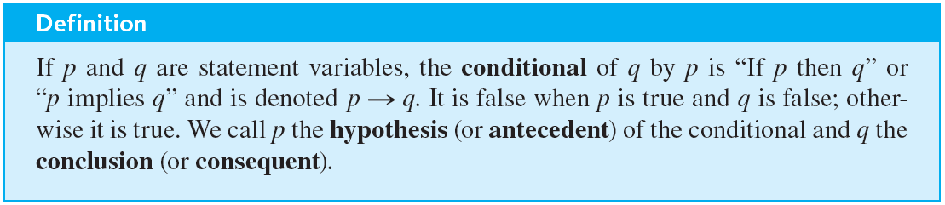
Conditional Statements
A conditional statement that is true by virtue of the fact that its hypothesis is false is often called vacuously true or true by default.

Slide 4
Example 2.2.1 – A Conditional Statement with a False Hypothesis
Consider the statement
If 0 = 1 then 1 = 2.
As strange as it may seem, since the hypothesis of this statement is false, the statement as a whole is true.

Slide 5
Conditional Statements
In expressions that include
as well as other logical operators such as ∧, ∨, and
the order of operations is that
is performed last.

Slide 6

Example 2.2.2 – Truth Table for
Construct a truth table for the statement form

Slide 7

Example 2.2.2 – Solution
By the order of operations given, the following two expressions are equivalent:
and this order governs the construction of the truth table.
First fill in the four possible combinations of truth values for p and q, and then enter the truth values for
using the definition of negation. Next fill in the
column using the definition of ∨.

Slide 8
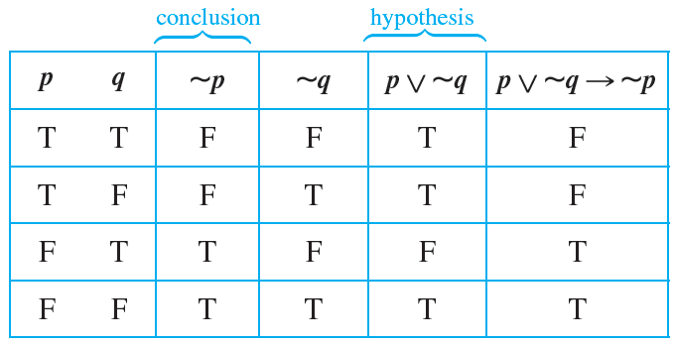
Example 2.2.2 – Solution
continued
Finally, fill in the
column using the definition of .

Slide 9
Logical Equivalences Involving

Slide 10

Example 2.2.3 – Division into Cases: Showing That
Use truth tables to show the logical equivalence of the statement forms p ∨ q →
r and (p
r). Annotate the table with a sentence of explanation.
r) ∧ (q

Slide 11
Example 2.2.3 – Solution
First fill in the eight possible combinations of truth values for p, q, and r. Then fill in the columns for p ∨ q, p
r, and q
r using the definitions of or and if-then. For instance, the p
r column has F’s in the second and fourth rows because these are the rows in which p is true and r is false.
Next fill in the p ∨ q →
r column using the definition of if-then. The rows in which the hypothesis p ∨ q is true and the conclusion r is false are the second, fourth, and sixth. So F’s go in these rows and T’s in all the others.

Slide 12
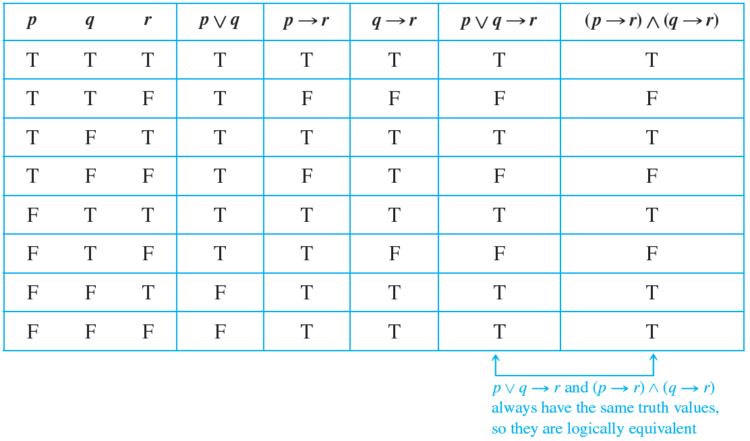
Example 2.2.3 – Solution
continued
The complete table shows that p ∨ q
r and (p
r) ∧ (q
r) have the same truth values for each combination of truth values of p, q, and r. Hence the two statement forms are logically equivalent.

Slide 13
Representation of If-Then as Or

Slide 14

Example 2.2.4 – Application of the Equivalence between
Rewrite the following statement in if-then form.
Either you get to work on time or you are fired.

Slide 15


Example 2.2.4 – Solution
Also p is
You do not get to work on time.
Let
be
You get to work on time.
and q be
You are fired.
Then the given statement is

Slide 16
Example 2.2.4 – Solution
continued
q, is
If you do not get to work on time, then you are fired.
So the equivalent if-then version, p

Slide 17
The Negation of a Conditional Statement

Slide 18

The Negation of a Conditional Statement
By definition, p
q is false if, and only if, its hypothesis, p, is true and its conclusion, q, is false. It follows that
This can be restated symbolically as follows:

Slide 19

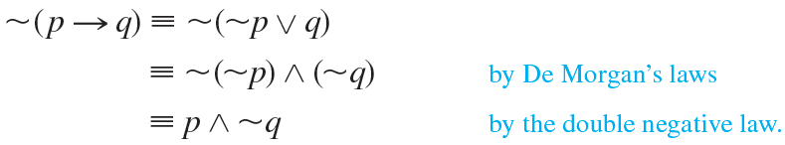
The Negation of a Conditional Statement
To obtain this result you can also start from the logical equivalence
Take the negation of both sides to obtain

Slide 20
Example 2.2.5 – Negations of If-Then Statements
Write negations for each of the following statements:
a. If my car is in the repair shop, then I cannot get to class.
b. If Sara lives in Athens, then she lives in Greece.

Slide 21
Example 2.2.5 – Solution
a. My car is in the repair shop and I can get to class.
b. Sara lives in Athens and she does not live in Greece. (Sara might live in Athens, Georgia; Athens, Ohio; or Athens, Wisconsin.)

Slide 22
The Contrapositive of a Conditional Statement

Slide 23
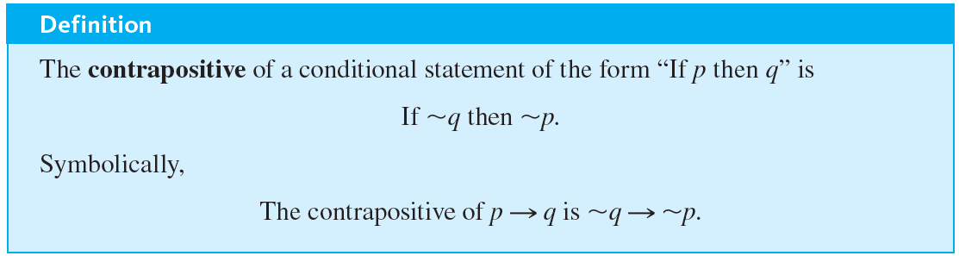
The Contrapositive of a Conditional Statement
One of the most fundamental laws of logic is the equivalence between a conditional statement and its contrapositive.

Slide 24
The Contrapositive of a Conditional Statement
The fact is that

Slide 25
Example 2.2.6 – Writing the Contrapositive
Write each of the following statements in its equivalent contrapositive form:
a. If Howard can swim across the lake, then Howard can swim to the island.
b. If today is Easter, then tomorrow is Monday.

Slide 26
Example 2.2.6 – Solution
a. If Howard cannot swim to the island, then Howard cannot swim across the lake.
b. If tomorrow is not Monday, then today is not Easter.

Slide 27
The Converse and Inverse of a Conditional Statement

Slide 28
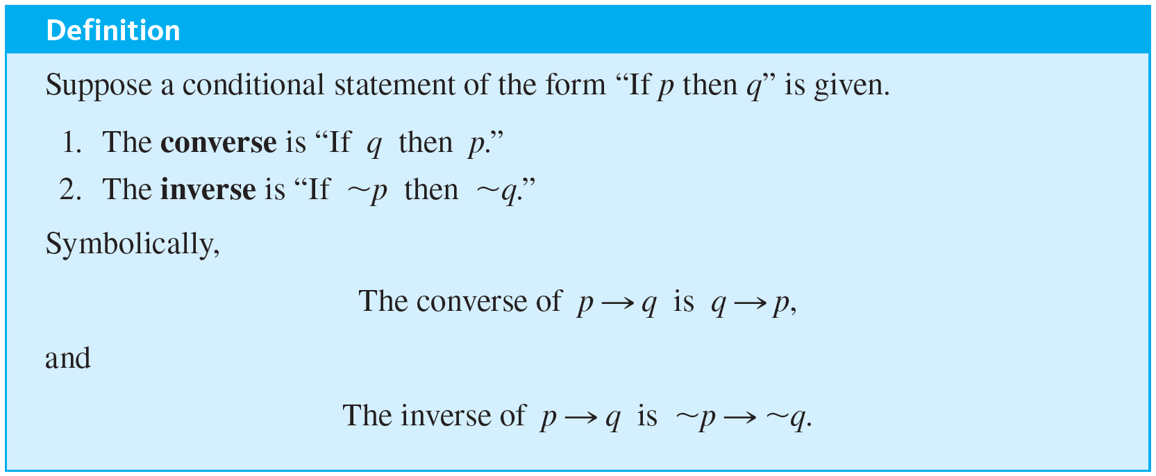
The Converse and Inverse of a Conditional Statement

Slide 29
Example 2.2.7 – Writing the Converse and the Inverse
Write the converse and inverse of each of the following statements:
a. If Howard can swim across the lake, then Howard can swim to the island.
b. If today is Easter, then tomorrow is Monday.

Slide 30
Example 2.2.7 – Solution
a. Converse: If Howard can swim to the island, then Howard can swim across the lake.
Inverse: If Howard cannot swim across the lake, then Howard cannot swim to the island.
b. Converse: If tomorrow is Monday, then today is Easter.
Inverse: If today is not Easter, then tomorrow is not Monday.

Slide 31
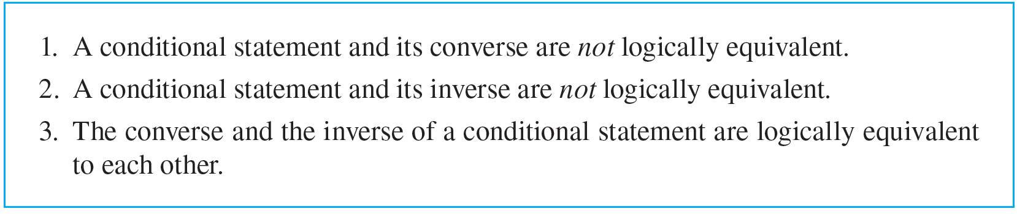
The Converse and Inverse of a Conditional Statement

Slide 32
Only If and the Biconditional

Slide 33
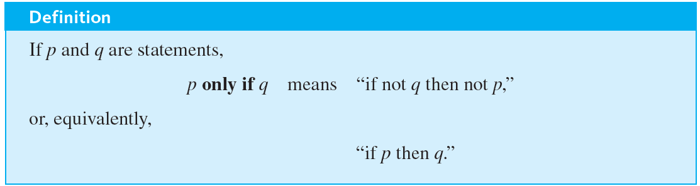
Only If and the Biconditional

Slide 34
Example 2.2.8 – Converting Only If to If-Then
Rewrite the following statement in if-then form in two ways, one of which is the contrapositive of the other.
John will break the world’s record for the mile run only if he runs the mile in under four minutes.

Slide 35
Example 2.2.8 – Solution
Version 1: If John does not run the mile in under four minutes, then he will not break the world’s record.
Version 2: If John breaks the world’s record, then he will have run the mile in under four minutes.

Slide 36
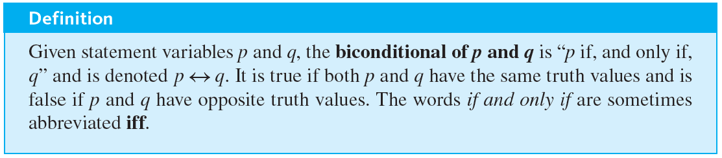
Only If and the Biconditional

Slide 37
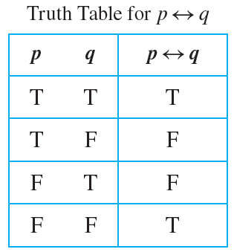
Only If and the Biconditional
The biconditional has the following truth table:

Slide 38
Only If and the Biconditional
In order of operations
is coequal with .
As with ∧ and ∨, the only way to indicate precedence between them is to use parentheses.

Slide 39
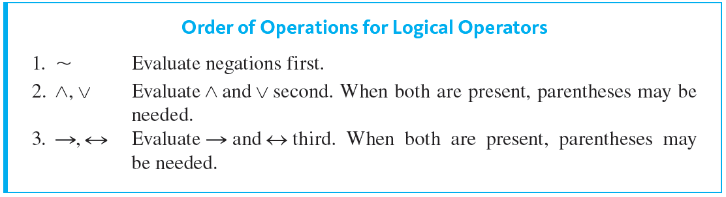
Only If and the Biconditional
The full hierarchy of operations for the five logical operators is shown below.

Slide 40
Example 2.2.9 – If and Only If
Rewrite the following statement as a conjunction of two if-then statements:
This computer program is correct if, and only if, it produces correct answers for all possible sets of input data.

Slide 41
Example 2.2.9 – Solution
If this program is correct, then it produces the correct answers for all possible sets of input data; and if this program produces the correct answers for all possible sets of input data, then it is correct.

Slide 42
Necessary and Sufficient Conditions

Slide 43
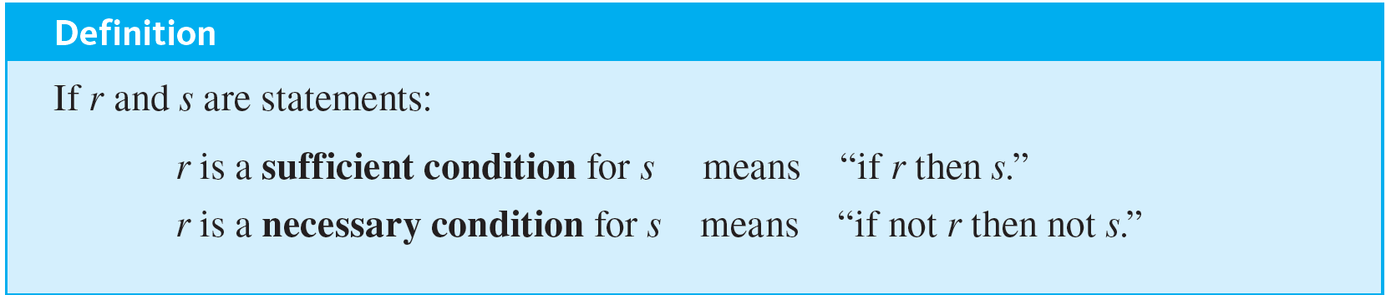
Necessary and Sufficient Conditions

Slide 44
Example 2.2.11 – Converting a Sufficient Condition to If-Then Form
Rewrite the following statement in the form “If A then B”:
Pia’s birth on U.S. soil is a sufficient condition for her to be a U.S. citizen.

Slide 45
Example 2.2.11 – Solution
If Pia was born on U.S. soil, then she is a U.S. citizen.

Slide 46
Example 2.2.12 – Converting a Necessary Condition to If-Then Form
Use the contrapositive to rewrite the following statement in two ways:
George’s attaining age 35 is a necessary condition for his being president of the United States.

Slide 47
Example 2.2.12 – Solution
Version 1: If George has not attained the age of 35, then he cannot be president of the United States.
Version 2: If George can be president of the United States, then he has attained the age of 35.

